Slide 1


EventFlow
EVENT MANAGEMENT SYSTEM
Milestone 1
Project Proposal
Team 12
1.

Slide 2





EventFlow
Meet Our Team
Ravindu Abesinghe
Nilakshi Induwara
Nipuni Sathya
E/19/004
E/19/028
E/19/167
Shenal Mendis
Prageeth Dananjaya
E/19/240
E/19/431
Team 12
2.

Slide 3

The Problem
Event Organizer
No way to analyze, access and improve Events
3.

Slide 4

The Problem
Event Attendee
Quick access to event info and
schedule is blocked behind apps
4.

Slide 5

Solution
A Human-less Event Attendance management system

Slide 6

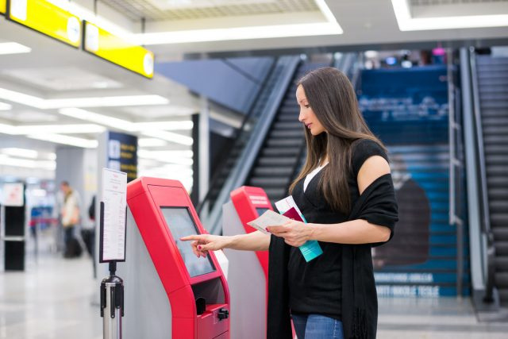
EventFlow
What our system does
Tracks and analyses attendees entering and leaving
Displays information on attendee’s event information through a hub
Team 12
6

Slide 7






EventFlow
Central hub and nodes
Display unit
User with RFID card
Web app
Logic (application)
High-level Architecture
The overview of the system
Cloud db
Team 12
7.

Slide 8
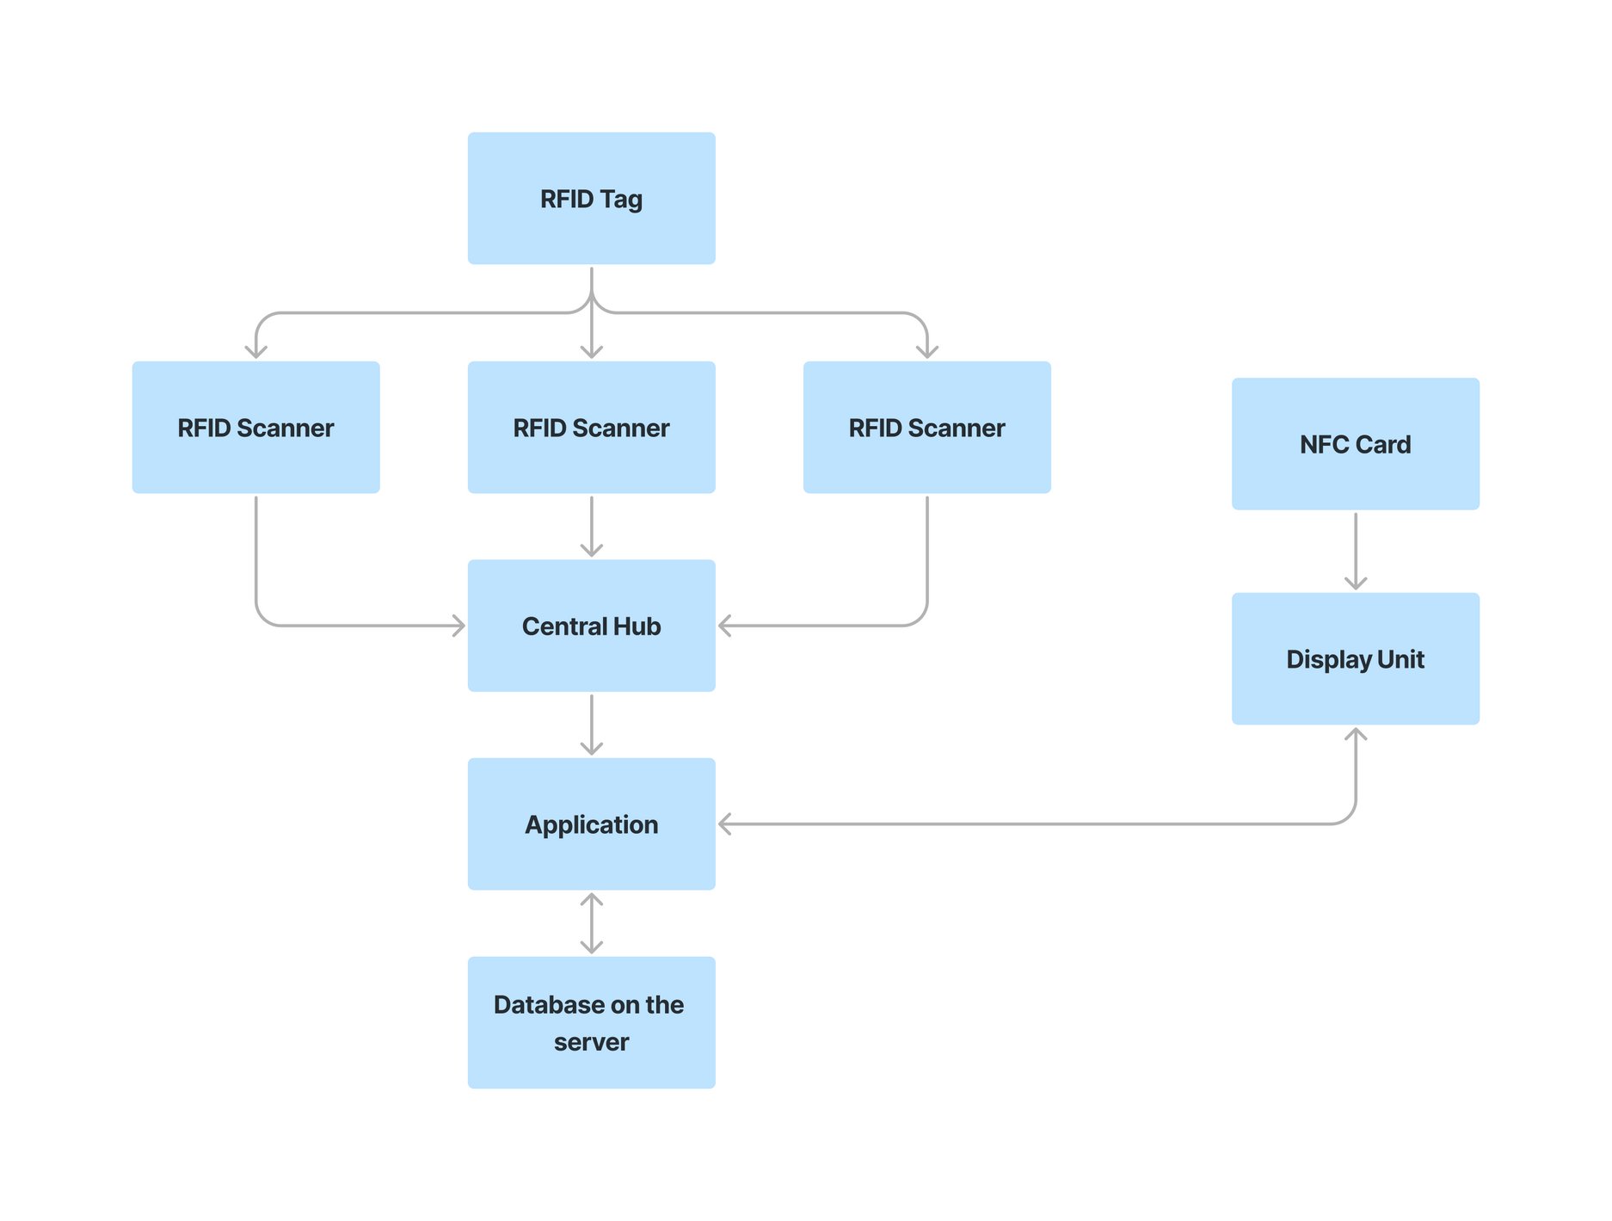

EventFlow
T
T
T
T
Data Flow
Data flow through the complete system.
T
Temperary data storage
P
P
Permenent data storage
Team 12
10.
8.

Slide 9
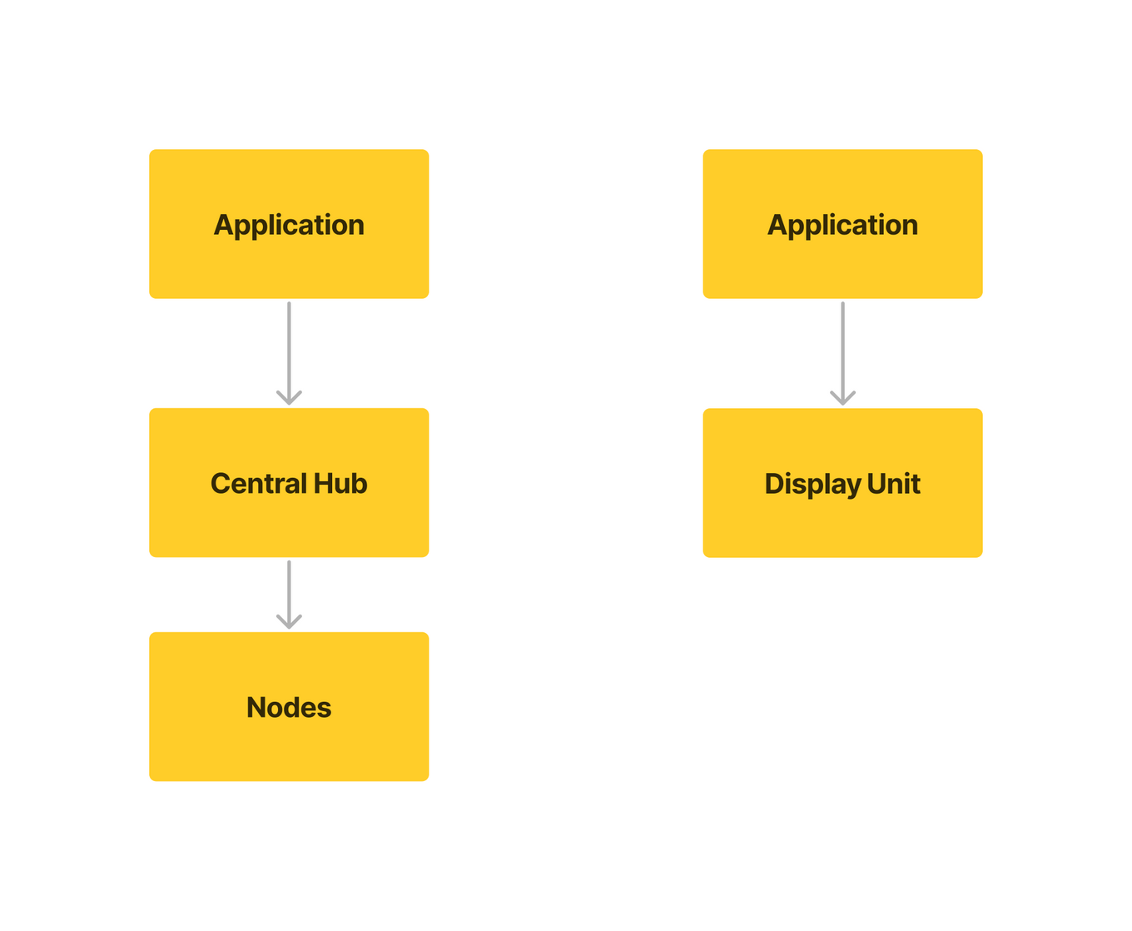
EventFlow
Data recieval
Database logic
Node control
Control Flow
Device Failure
Heighrachy of control through the complete system.
sending data
Team 12
9.

Slide 10



EventFlow
Event Manager
Event Attendee
Data Visualization
Data flow through the complete system.
Web Application
Display Unit
Team 12
10.

Slide 11



EventFlow
Tech Stack
Cloud Server and Database
flexible
scalable
time-series data
Scalable
reliable
Team 12
11.

Slide 12





EventFlow
Tech Stack
Front and Back end
web application framework
robust and scalable
routing and request processing
declarative syntax
component-based
React Native
real-time and
bidirectional communication
non-blocking I/O model
scalable
large number of connections
Team 12
12.

Slide 13


EventFlow
Tech Stack
Micro-controller
For ESP32NODEMCU
For RaspberryPi
Team 12
13.

Slide 14

EventFlow
Communication Technologies
Data communication primarily occurs between the Central Hub and Sensors, as well as between the Central Hub ,Server and the Application.
Main Communication Method
High Data Transfer Speed
Extended Range
Multiple Connections
Reliable Communication
Team 12
14
Notes:
So in our System Data communication mainly happens Between the Central Hub and Sensors and between the Central Hub and the Application.
......Rather than Bluetooth or RFID Because both of those technologies are good for short-range communication. and also RFID is a one-way communication method .So that is why we choose Wi-fi choosing that we can have these benefits also ...

Slide 15


EventFlow
Protocols
Transmission between Nodes & Central Hub , Server & Central Hub
Real-Time Communication
Reduced Latency
Minimized Data Transfer Overhead
Transmission between Server & Display unit
Standard and widely supported protocol.
RESTful APIs
Security (HTTPS)
Team 12
15.
Notes:
1
real-time Data transmission.
WebSocket minimizes latency by maintaining a persistent connection.
WebSocket has lower overhead compared to traditional HTTP.
2
HTTP/HTTPS is a widely adopted and standardized protocol,
HTTP is commonly used for building RESTful APIs,
HTTPS provides a layer of encryption,

Slide 16

EventFlow
Hardware Stack
Attendance Tracking Unit
Central Hub
Information Unit
Team 12
16.
Notes:
1
real-time Data transmission.
WebSocket minimizes latency by maintaining a persistent connection.
WebSocket has lower overhead compared to traditional HTTP.
2
HTTP/HTTPS is a widely adopted and standardized protocol,
HTTP is commonly used for building RESTful APIs,
HTTPS provides a layer of encryption,

Slide 17



EventFlow
Attendance Tracking Unit
ESP32 NODEMCU
UHF RFID reader
flash Memory
Wireless connectivity
GPIO
dual core architecture
Contact-less
Automation and efficiency
Non- volatility
Unlimited writing cycles
Team 12
17.

Slide 18
EventFlow
Central Hub
ESP32 NODEMCU
Wireless connectivity
peripheral set
dual core architecture
Low power consumption
Team 12
18

Slide 19
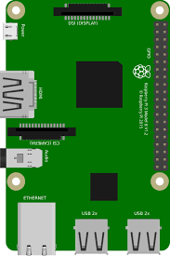

EventFlow
Information Unit
RFID reader
Raspberry Pi 3
Display
Low cost
Unique Identifier
compacted size
Processing Power
Inbuilt HDMI port
compacted size
Low cost
Team 12
19

Slide 20
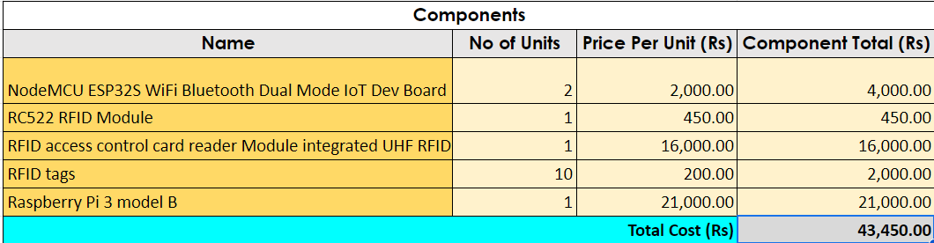
EventFlow
Budget
Team 12
20

Slide 21


EventFlow
Security
Authentication
AWS (Amazon IAM)
JSON Web Token (JWT)
Data Encryption
AWS (KMS)
AWS IoT Core
JSON Web Encryption (JWE)
HTTPS
Data Backup and Recovery
AWS Backup
Team 12
21.

Slide 22


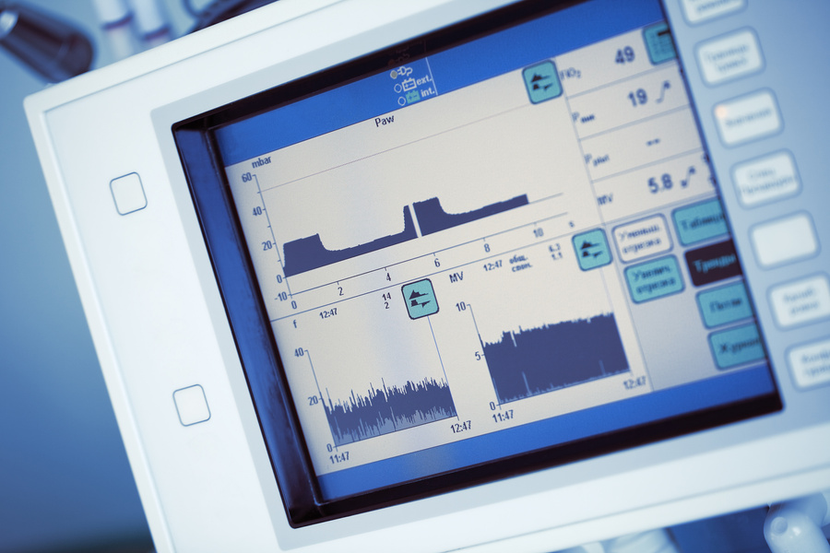


EventFlow
Demonstration Plan
Team 12
22.

Slide 23
EventFlow
Timeline
Nov 20
Nov 26
Nov 27
Dec 03
Dec 04
Dec 10
Dec 11
Dec 17
Dec 18
Dec 24
Dec 25
Dec 31
Jan 01
Jan 07
Jan 08
Jan 14
Jan 15
Jan 21
Jan 22
Jan 28
Jan 29
Feb 02
Finalize the Project Plan
Hardware Development
Software Development
Integration
Testing and QA
Documentation
Refine and bug-fixing
Team 12
23.

Slide 24
THANK
YOU!

Slide 25
Q & A

